Slide 1
Visual Designs
Nathan Share

Slide 2
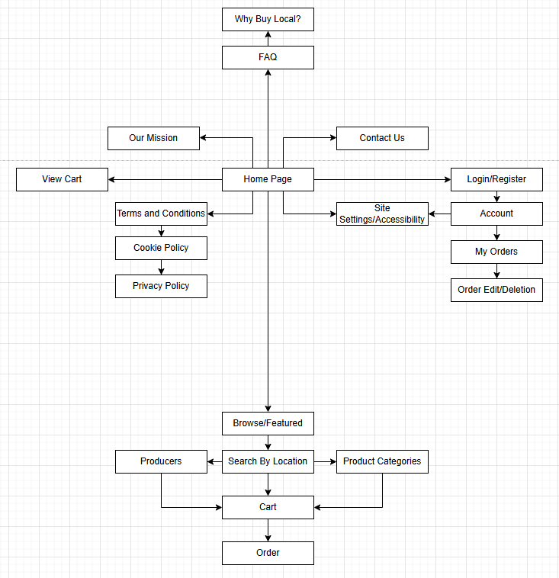
Sitemap – Greenfield Local Hub
For my sitemap, I decided to focus on a central homepage that branches out into several key sections of the site. The benefit of organising it this way is that related information remains together and simple to find, and it gives users who are new to the site a clear sense of grouped direction.
While this can slightly hinder navigation, I have chosen to keep even the furthest pages at a maximum of 4-5 clicks from the homepage, so that it is difficult to lose the page you’re looking for.
Furthermore, I have added the cart page in twice, once from the homepage, where the user can access it as a shortcut, and once before ordering, as a natural segue into the payment/order process.

Slide 3
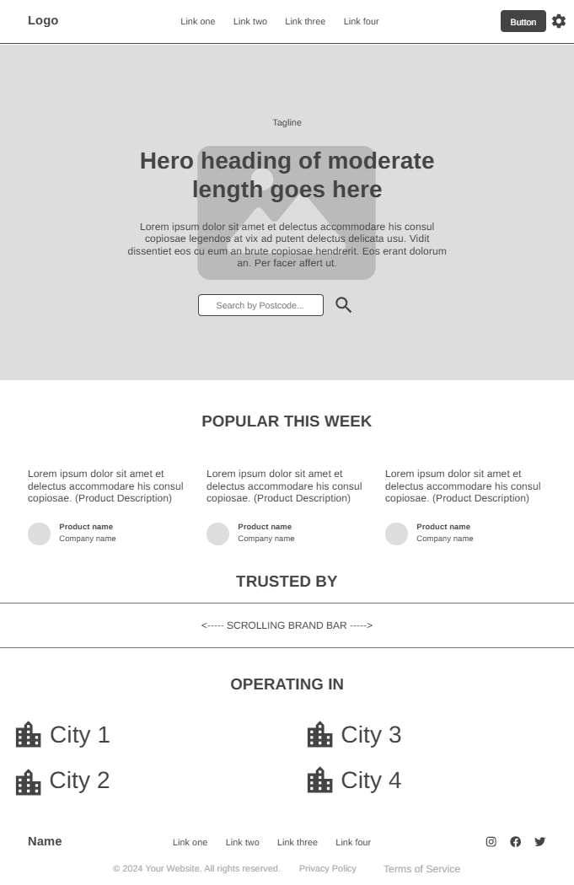
Wireframe – Homepage/Index Page Site Link

Slide 4
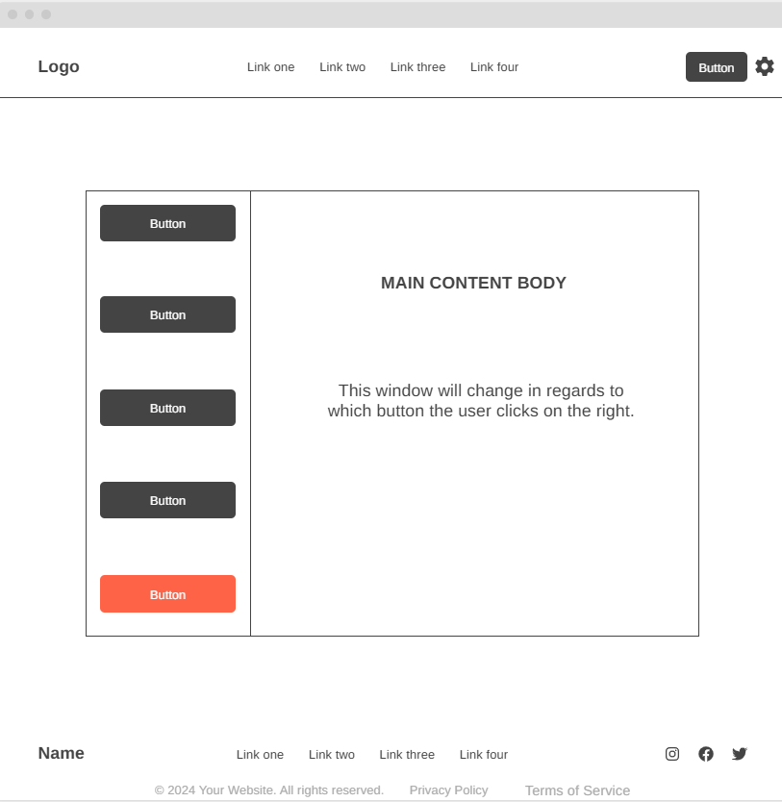
Wireframe – My Account Site Link

Slide 5
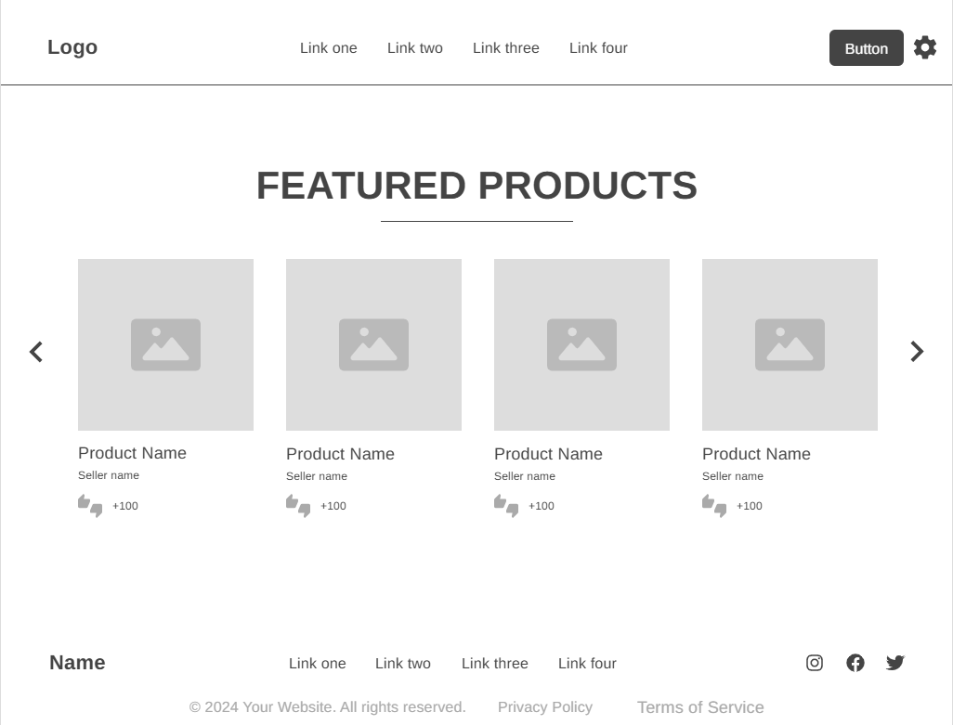
Wireframe – Featured Products Site Link

Slide 6
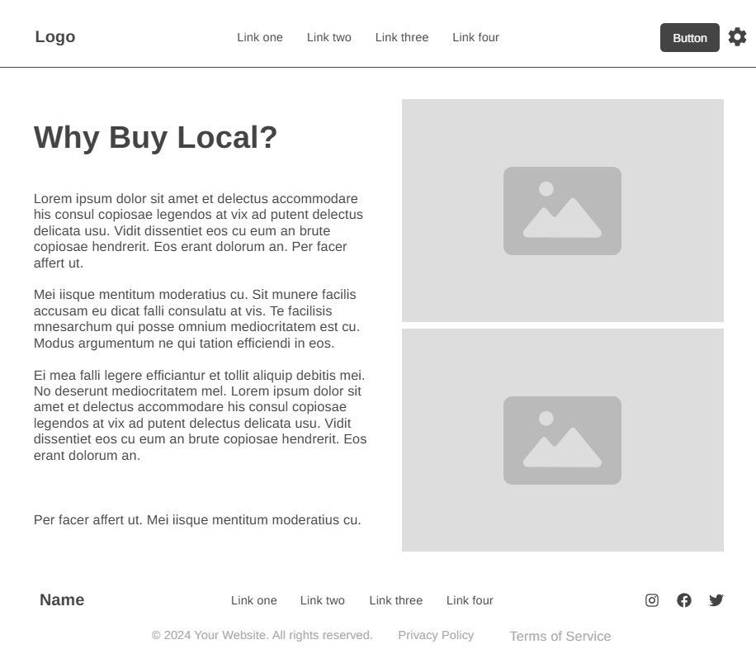
Wireframe – Why buy local? Site Link

Slide 7
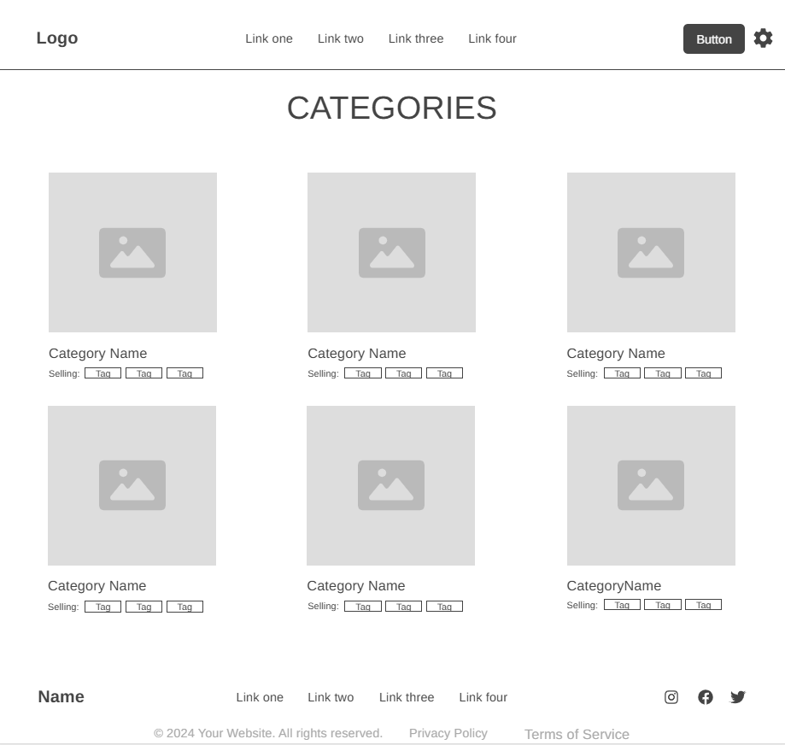
Wireframe – Product Categories Site Link

Slide 8
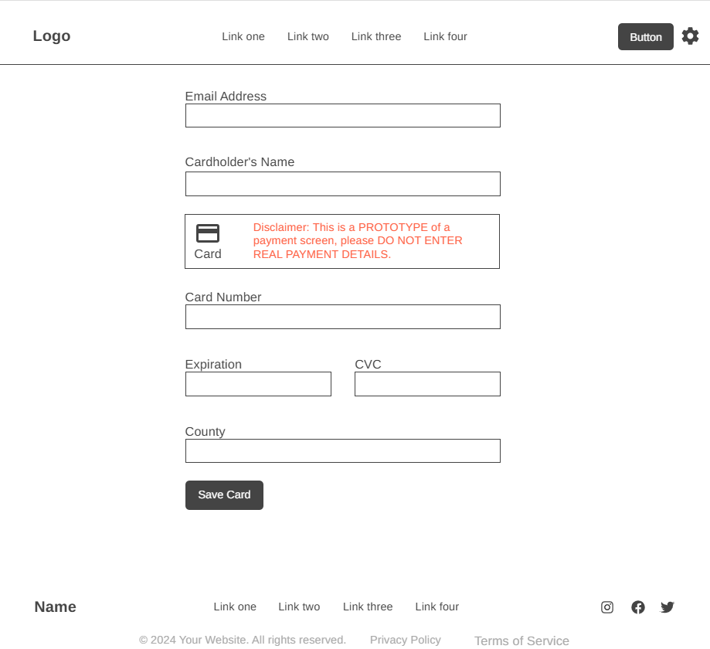
Wireframe – Order Site Link

